Slide 1

WATER LEVEL CONTROL USING FUZZY LOGIC SYSTEM
Name: Yousef Shaban

Slide 2
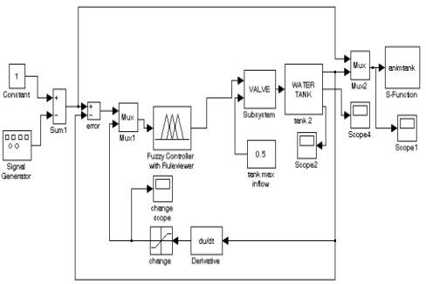
SYSTEM SIMULATION 1. Main theme of the project. Introduction:
After checking the word document, we realize that FIS controllers are more efficient towards what we aim for in this project.
So, our first steps would be to open MATLAB, create a new .slx project, start by implementing fuzzy logic by using Mamdani interface.
The following figure is what the final form of the project will look like:

Slide 3
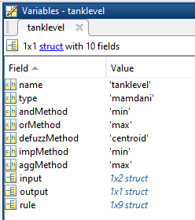
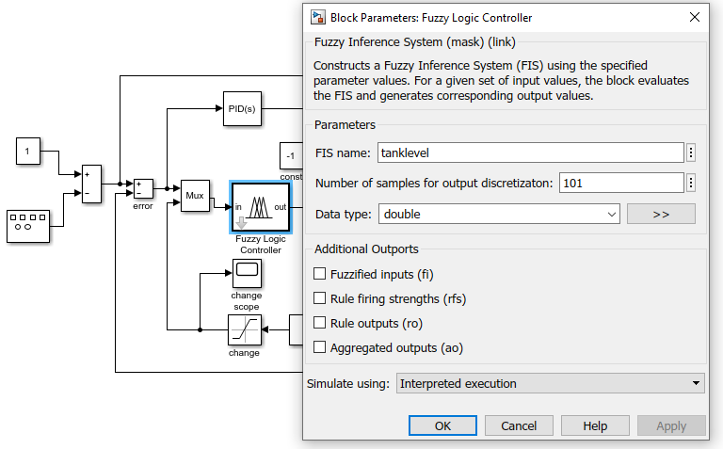
You can add the FIS file by importing it as a variable.

Slide 4
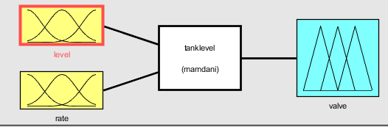
SYSTEM SIMULATION 2. Designing of Fuzzy Logic Controller A. FIS Editor
For the Fuzzy Controller, we have defined two Inputs. The first is the level of water in the tank, marked as "Level," and the second is the rate of change of water in the tank, designated as "Rate." Both of these Inputs are used by the Rule Editor. According to the Rules defined in the Rule Editor, the controller takes action and opens the Valve, which is the controller's output and is symbolized by "Valve."

Slide 5
SYSTEM SIMULATION 2. Designing of Fuzzy Logic Controller B. Membership Function Editor
The Membership Function Editor shares some features with the FIS Editor. In fact, all of the five basic graphical user interface tools have similar menu options. The MF Editor is the tool that let you display and edits all of the membership functions associated with all of the input and output variables for the entire fuzzy inference system. When you open the Membership Function Editor to work on a fuzzy inference system that does not already exist in the workspace, there is not yet any membership functions associated with the variables that you have just defined with the FIS Editor.
In the Following slides we’ll apply all negative, zero and positive values for each level and rate sets

Slide 6
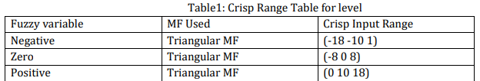
SYSTEM SIMULATION 2. Designing of Fuzzy Logic Controller B. Membership Function Editor
i. Fuzzy Set Characterizing Input
While creating the Fuzzy set characterize input (level), we need to define a range for the attributes, in which I placed the range (from -10 to 10).
Also, The Input Range for each variable will be as following:
The following three slides will be an implementation of the variables for level set

Slide 7
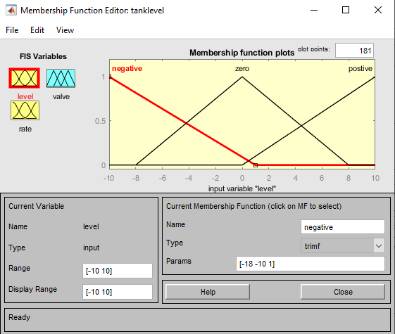

Slide 8
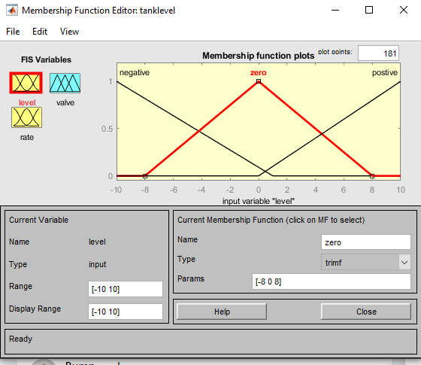

Slide 9
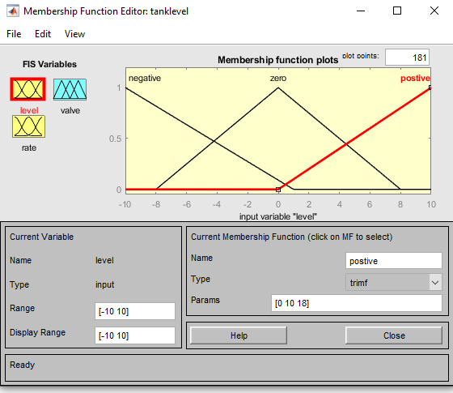

Slide 10
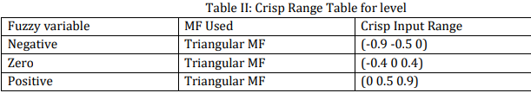
SYSTEM SIMULATION 2. Designing of Fuzzy Logic Controller B. Membership Function Editor
i. Fuzzy Set Characterizing Input
While creating the Fuzzy set characterize input (Rate), we need to define a range for the attributes, in which I placed the range (from -0.5 to 0.5).
Also, The Input Range for each variable will be as following:
The following three slides will be an implementation of the variables for rate set

Slide 11
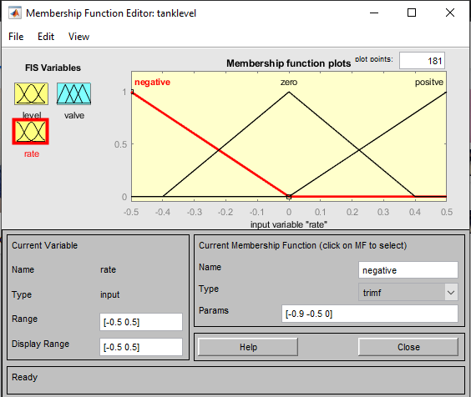

Slide 12
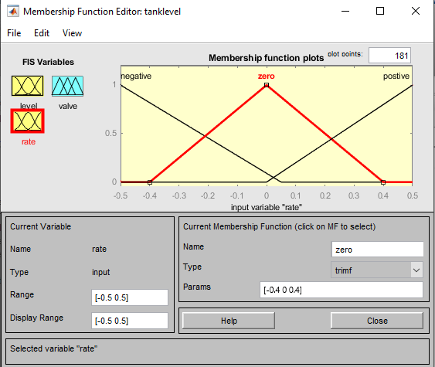

Slide 13


Slide 14

SYSTEM SIMULATION 2. Designing of Fuzzy Logic Controller B. Membership Function Editor
ii. Fuzzy Set Characterizing Output
While creating the Fuzzy set characterize output (Valve), we need to define a range for the attributes, in which I placed the range (from -5 to 5).
Also, The Input Range for each variable will be as following:
The following three slides will be an implementation of the variables for valve set

Slide 15
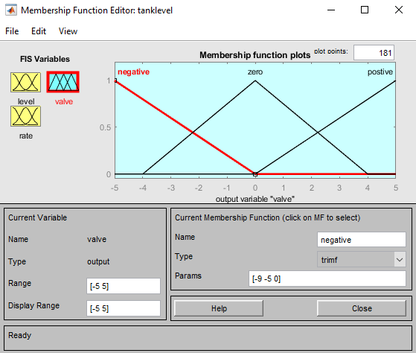

Slide 16
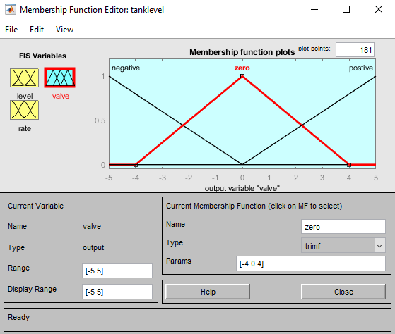

Slide 17
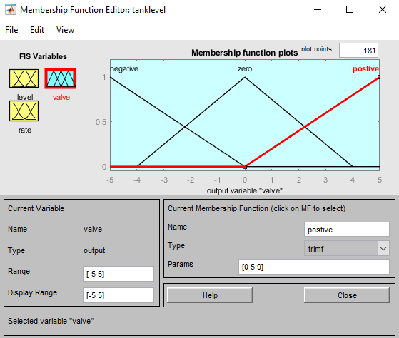

Slide 18
SYSTEM SIMULATION 2. Designing of Fuzzy Logic Controller C. Rule Editor
Creating rules with the graphical Rule Editor interface is reasonably self-explanatory. The Rule Editor generates rule statements automatically based on the input and output variables set in the FIS Editor.
1. If (Level is negative) and (Rate is negative) then (Valve is negative) (1).
2. If (Level is negative) and (Rate is zero) then (Valve is negative) (1).
3. If (Level is negative) and (Rate is positive) then (Valve is negative) (1).
4. If (Level is zero) and (Rate is negative) then (Valve is negative) (1).
5. If (Level is zero) and (Rate is zero) then (Valve is zero) (1).
6. If (Level is zero) and (Rate is positive) then (Valve is positive) (1).
7. If (Level is positive) and (Rate is negative) then (Valve is positive) (1).
8. If (Level is positive) and (Rate is zero) then (Valve is positive) (1).
9. If (Level is positive) and (Rate is positive) then (Valve is positive) (1).
The Following slide shows an Implementation to these rules:

Slide 19
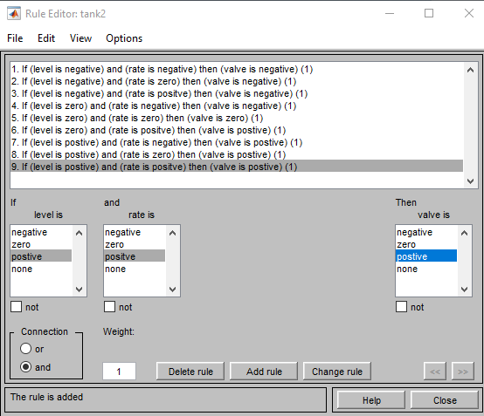

Slide 20
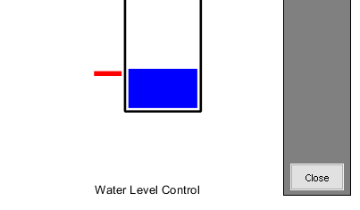
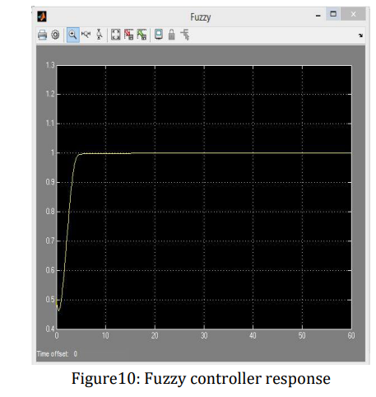
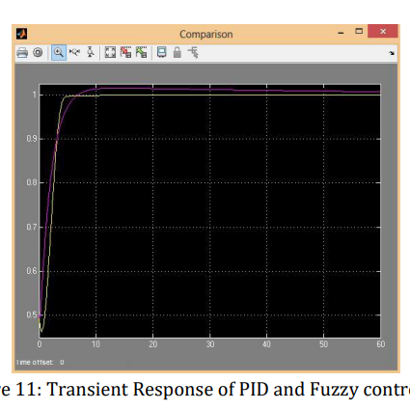
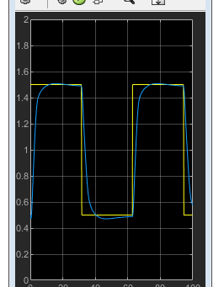
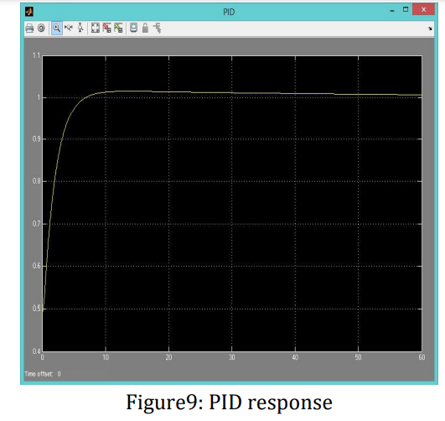
Thanks for listening

